Slide 1
PTA/OTA 106 Unit 1 Lecture 1B

Slide 2
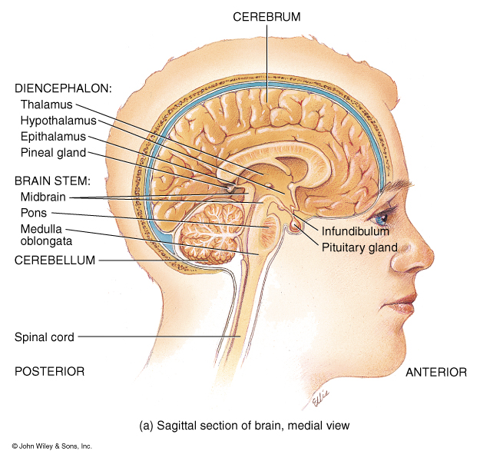
Structural and Functional areas of the Medulla Oblongata
Cardiovascular Center:
Regulates the rate and force of the heartbeat and the diameter of blood vessels
Medullary Rhythmicity Area:
adjusts the basic rhythm of breathing via inspiratory and expiratory areas.
Other centers for vomiting,
coughing, and sneezing

Slide 3
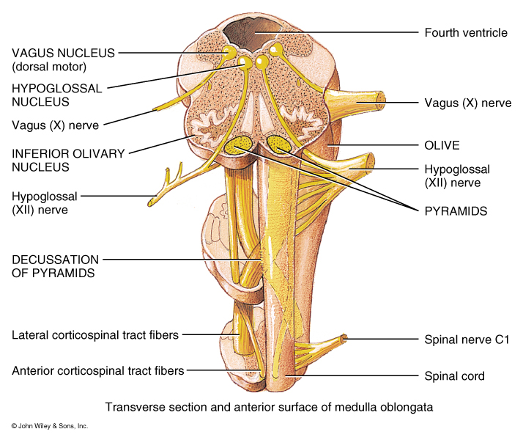
Structural and Functional areas of the Medulla Oblongata
Pyramids:
Axons from the largest motor tracts from the cerebrum to the Spinal Cord.
Decussation of Pyramids:
Crossing of the motor tracts of the pyramids
Nucleus Gracilis: Neuron cells bodies of second order neurons (sensory info)
Nucleus Cuneatus: Neuron cells bodies of second order neurons (sensory info)

Slide 4
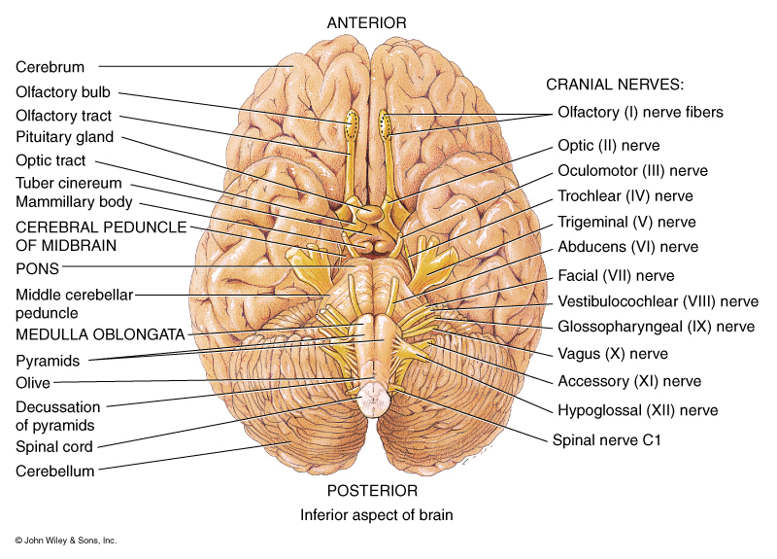
Structural and Functional areas of the Medulla Oblongata
Contains the Nuclei of five cranial nerves:
Vestibulocochlear
Receive sensory and motor impulses for the cochlea
Glossopharyngeal
Relay sensory and motor impulses related to taste, swallowing, and salivation
Vagus
Sensory and motor impulses for viscera

Slide 5
Structural and Functional areas of the Medulla Oblongata
Contains the Nuclei of five cranial nerves:
Spinal Accessory
Origin for nerve impulses that control swallowing.
Hypoglossal
Origin for impulses that control tongue movement for speech and swallowing

Slide 6
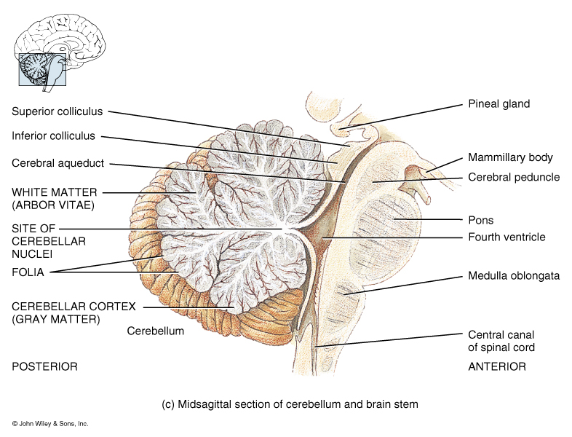
Structural and Functional areas of the Pons
Bridge the connects medulla and superior brain structures
Longitudinal axons of ascending sensory and descending motor tracts
Transverse axons connect the right and left sides of the cerebellum
Pneumotaxic Area:
transmits inhibitory impulses to the inspiratory area of the Medullary rhythmicity area

Slide 7
Structural and Functional areas of the Pons
Apneustic Area:
Transmits stimulatory impulses to the inspiratory area
Contains the nuclei of four cranial nerves
Trigeminal:
receive somatic sensory impulses from the head and face. Motor impulses the control chewing
Abducens:
Motor impulses to the Lateral Rectus muscle.

Slide 8
Structural and Functional areas of the Pons
Facial:
Receive sensory impulses for taste and provide motor impulses that regulate saliva, tears, and muscle of facial expression
Vestibulocochlear:
Sensory impulses related to balance and equilibrium

Slide 9
Structural and Functional areas of the midbrain or mesencephalon
Cerebral Peduncles:
Tracts that contain axons from the corticospinal and corticobulbar motor neurons
Sensory tracts from the pons and medulla that extend to the thalamus
Corpora Quadrigemina:
Superior colliculi: reflex center for movement of the eyes and head in response to visual stimuli.
Inferior colliculi: reflex center for movement of the head and trunk in response to auditory stimuli.

Slide 10
Structural and Functional areas of the midbrain or mesencephalon
Sustantia nigra:
Nuclei that control subconscious muscle activities through the production of dopamine
Red Nuclei: relay area for motor tracts that control coordinated muscular movements
Headquarters of the Reticular formation, the reticular activating system (RAS). Network of interconnected nuclei throughout the brain that produces heightened alertness and excitement or generalized lethargy and sleep

Slide 11
Function and Structure of the Reticular Formation
The Reticular Activating System is the attention center in the brain. It is the key to "turning on your brain," and also seems to be the center of motivation. Ie, helps mediate transitions from sleep and relaxed wakefulness to periods of high attention.
In order that the brain may sleep, there must be a reduction in ascending afferent activity reaching the cortex by suppression of the RAS
the Reticular Activating System is a very complex collection of neurons that serve as a point of convergence for signals from the external world and from interior environment.
It plays a significant role in determining whether a person can learn and remember things well or not, on whether or not a person is impulsive or self-controlled, on whether or not a person has high or low motor activity levels, and on whether or not a person is highly motivated or bored easily.

Slide 12
Function and Structure of the Reticular Formation
Developmental Influences:
Preterm birth: Regardless of birth weight or weeks of gestation, premature birth induces persistent deleterious effects on pre-attentional (arousal and sleep-wake abnormalities), attentional (reaction time and sensory gating), and cortical mechanisms throughout development
Smoking during pregnancy: exposure to cigarette smoke is known to produce lasting arousal, attentional and cognitive deficits in humans

Slide 13
Function and Structure of the Reticular Formation
Pathologies:
Given the importance of the RAS for modulating cortical changes, disorders of the RAS should result in alterations of sleep-wake cycles and disturbances in arousal. Has been implicated in:
Schizophrenia
Narcolepsy
Progressive supranuclear palsy (PSP)
Depression, autism, Alzheimer’s disease, attention deficit disorder

Slide 14
Structural and Functional areas of the midbrain or mesencephalon
Nuclei associated with two cranial nerves:
1. Oculomotor: controls movement of the eyeballs, constriction of the pupil, and shape of the lens
2. Trochlear controls movement of the eyeballs, specifically the Superior oblique muscle.

Slide 15
Structural and Functional areas of the Cerebellum
Second-largest part of the brain
with the motor areas of cerebrum to help provide smooth and coordinated skeletal muscle contractions and movements
Folia: leave like gray matter of the cerebellar cortex
Arbor Vitae: white matter tracts
Connections:
Inferior Cerebellar Peduncles
Medulla to cerebellum
Middle Cerebellar Peduncles
Pons to cerebellum
Superior Cerebellar Peduncles
Midbrain to cerebellum

Slide 16
Structural and Functional areas of the Cerebellum
Responsible for muscle synergy (coordination)
Coordinates the action of muscle groups
Is a monitor of other neurological centers, such as those the initiate muscle contractions and auditory and visual centers.
Dysfunction: Viral infections (Epstein-Barr, mycoplasma pneumonia, chickenpox) / lesions
Ataxia: uncoordinated muscle activity
Tremor: particularly intention tremor
Nystagmus: involuntary eye movement

Slide 17
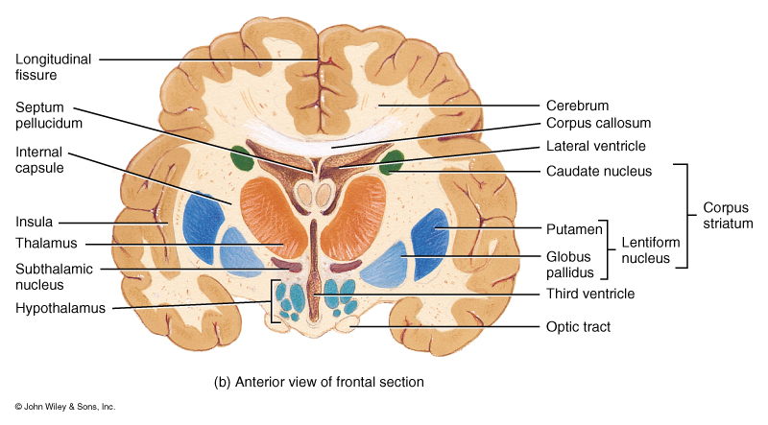
Structural and Functional areas of the Diencephalon
Thalamus:
Masses of gray matter organized into nuclei with interspersed tracts of white matter.
Functions as a principal relay station for sensory impulses and cognition
Intermediate Mass:
Bridge of gray matter connecting right and left sides

Slide 18
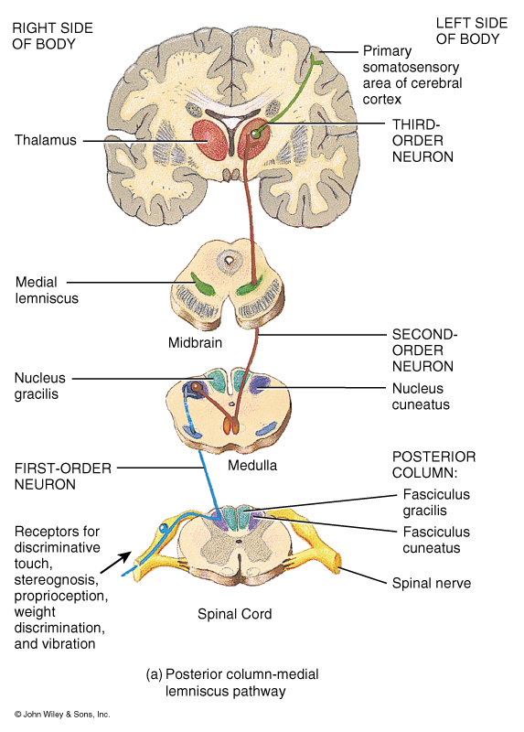
Structural and Functional areas of the Diencephalon
Thalamus:
Masses of gray matter organized into nuclei with interspersed tracts of white matter.
Functions as a principal relay station for sensory impulses and cognition
Intermediate Mass:
Bridge of gray matter connecting right and left sides

Slide 19
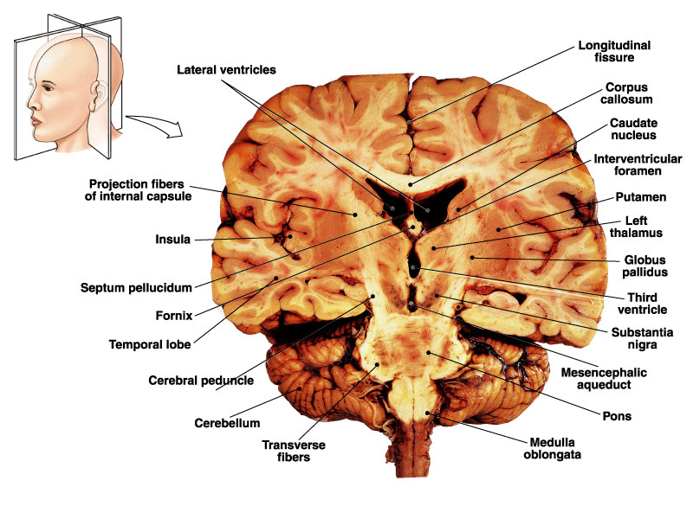
Structural and Functional areas of the Diencephalon
Nuclei of the Thalamus:
Medial Geniculate Nucleus:
Relays auditory impulses
Lateral Geniculate Nucleus
Relays visual impulses
Ventral Geniculate Nucleus
Relays impulses of taste, somatic touch, somatic pressure, somatic temperature, somatic pain

Slide 20
Structural and Functional areas of the Diencephalon
Hypothalamus:
Controls many body activities and is one of the major regulators of homeostasis.
Mammillary Bodies:
relay center for reflexes related to smell
Infundibulum:
Connect the hypothalamus to the pituitary gland.

Slide 21
Structural and Functional areas of the Diencephalon
Hypothalamus major functions:
Controls and integrates activities of the Autonomic nervous system
Produces Hormones that control the activity of the pituitary gland
Produces hormones that control urine production, labor contractions, and milk let-down
Regulation of emotional and behavioral patterns related to rage, aggression, pain, pleasure, and behavioral patterns related to sexual arousal

Slide 22
Structural and Functional areas of the Diencephalon
Hypothalamus major functions:
Regulation of eating and drinking
Feeding center (hunger)
Satiety center (inhibits feeding center)
Thirst Center
6. Control of body temperature
7. Regulation of circadian rhythms and states of consciousness

Slide 23
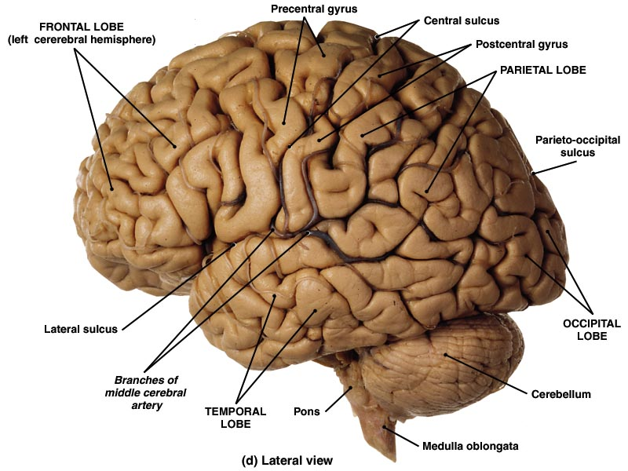
Structural and Functional areas of the of the cerebral hemispheres
Cerebral cortex: Integration and processing of sensory input and initiation of motor activities
a. Frontal: voluntary control of skeletal muscles
b. Parietal: Sensory perception
c. Occipital: visual stimuli
d. Temporal: auditory and olfactory stimuli

Slide 24
Structural and Functional areas of the of the cerebral hemispheres
2. Cerebral Nuclei:
Subconscious control of skeletal muscle tone and the coordination of learned movement patterns

Slide 25
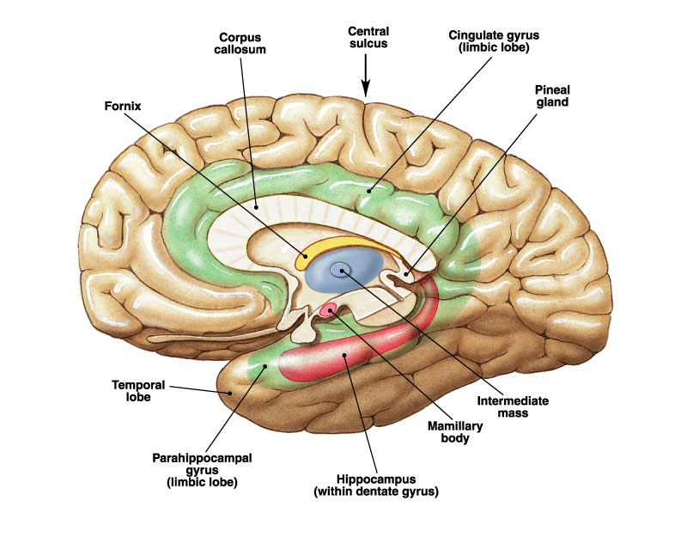
Organization of the Limbic System

Slide 26
Functions of the Limbic System
Considered the Motivational Brain
Establish emotional states
particularly those essential for self-preservation (feeding, fight, and flight, fear, and anger)
Essential for sex and parenting
Links conscious, intellectual functions with unconscious and autonomic functions
Facilitates memory storage and retrieval

Slide 27
Functions of the Limbic Nuclei
Amygdaloid body or Amygdala: Plays a key role in emotions. Is linked to both fear responses and pleasure. Is responsible for determining what memories are stored and where the memories are stored in the brain. It is thought that this determination is based on how huge an emotional response an event invokes. Believed to act as an interface between limibic system, cerebum, and other sensory areas.
Clinical concerns: Autism, Depression, Narcolepsy, Post-traumatic stress disorder, and Phobias are suspected to be related to dysfunction of these nuclei. Dysfunction can occur from damage, developmental problems, and neurotransmitter imbalance.

Slide 28
Functions of the Limbic Nuclei
Hippcampus: Plays a key role in memory and spatial navigation (recording information about one's environment and its spatial orientation). Sends memories out to the appropriate part of the cerebral hemisphere for long-term storage and retrieves them when necessary. Damage to this area of the brain may result in an inability to form new memories (anterograde amnesia) and often also affects memories formed before the damage (retrograde amnesia).
Clinical concerns: Alzheimer’s affects this area first. Damage can also result from anoxia and encephalitis.

Slide 29
Functions of the Limbic Nuclei
Two types of brain cell (neuron) damage are common in people who have Alzheimer's:
Plaques. Clumps of a normally harmless protein called beta-amyloid may interfere with communication between brain cells. Although the ultimate cause of neuron death in Alzheimer's isn't known, mounting evidence suggests that the abnormal processing of beta-amyloid protein may be the culprit.
Tangles. The internal support structure for brain cells depends on the normal functioning of a protein called tau. In people with Alzheimer's, threads of tau protein undergo alterations that cause them to become twisted. Many researchers believe this may seriously damage neurons, causing them to die.

Slide 30
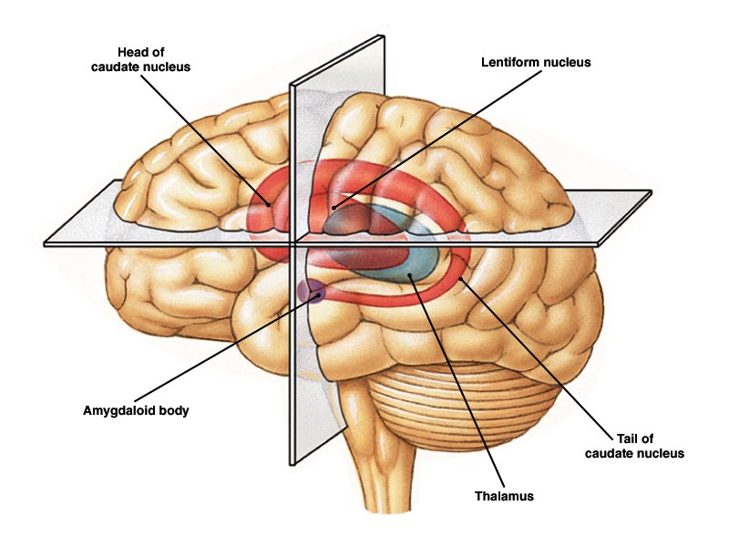
Organization of the Basal Nuclei or ganglia

Slide 31
Primary Function of the Basal Ganglia
Basal ganglia (nuclei) are involved with the subconscious control of skeletal muscle tone and the coordination of learned patterns
These nuclei do not initiate movement.
As you begin a voluntary movement the basal nuclei control and adjust muscle tune of the appendicular muscles

Slide 32
Functions of Basal Ganglia Nuclei
(Striatum) Caudate and Putamen Nuclei: Best known for a role in the planning and modulation of movement pathways, also involved in a variety of other cognitive processes involving executive functions.
Substantia nigra: Thought to be involved in movement and attention. Consists of two parts, the pars compacta and pars reticulata.
Pars compacta: produces and releases the neurotransmitter dopamine
Pars reticulata:Largely involved with control of eye muscles, coordinates activity with the superior colliculus.

Slide 33
Functions of Basal Ganglia Nuclei
Clinical concerns:
Age related loss of dopaminergic neurons
Encephalitis viral loss of dopaminergic neurons
Toxins such as MPTP (1-methyl-4-phenyl-1,2,3,6-tetrahydropyridine) is from heroin can cause degeneration of the pars compacta by destroying dopaminergic neurons .
The decreased dopamine levels are associated with
Parkinsons disease
Schizophrenia
psychomotor retardation seen in cliincal drepression.

